Slide 1

Spec Reader

Slide 2
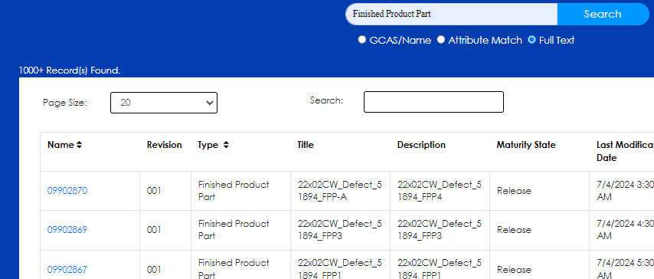
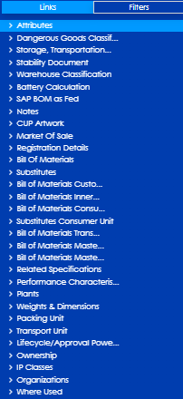
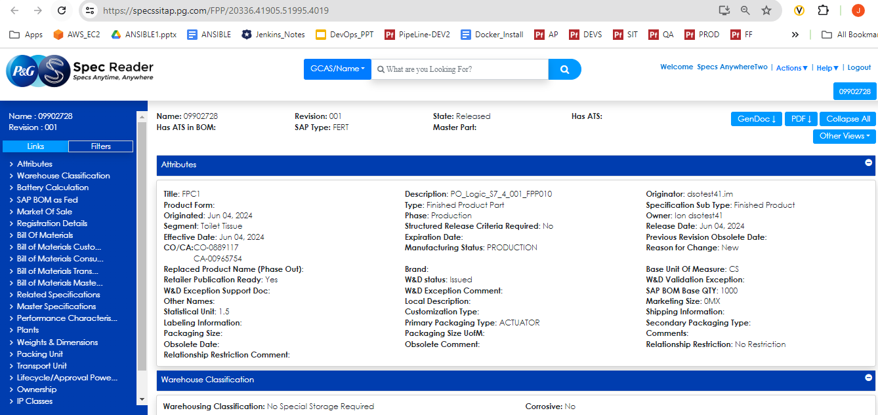
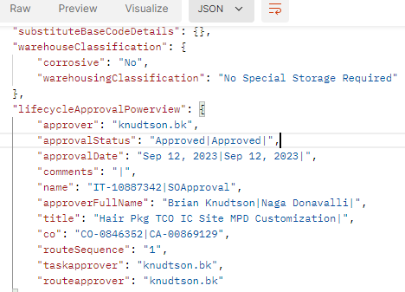
Requirement 5228 : Objects should take less than 15 seconds to load on the page (1/4)
Current Approach to load an Object:
UI
MS
MQL(Enovia)
Context Creation
Decide User profile
Security
Enovia APIs
Data retrieval
</fpp/{searchId}>
Send Request with ID
Data Collection
Spec Reader DB
UI
MS
MQL
(Enovia)
Display Properties Page
<JSON>

Slide 3
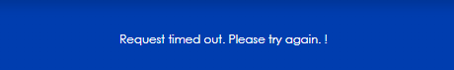
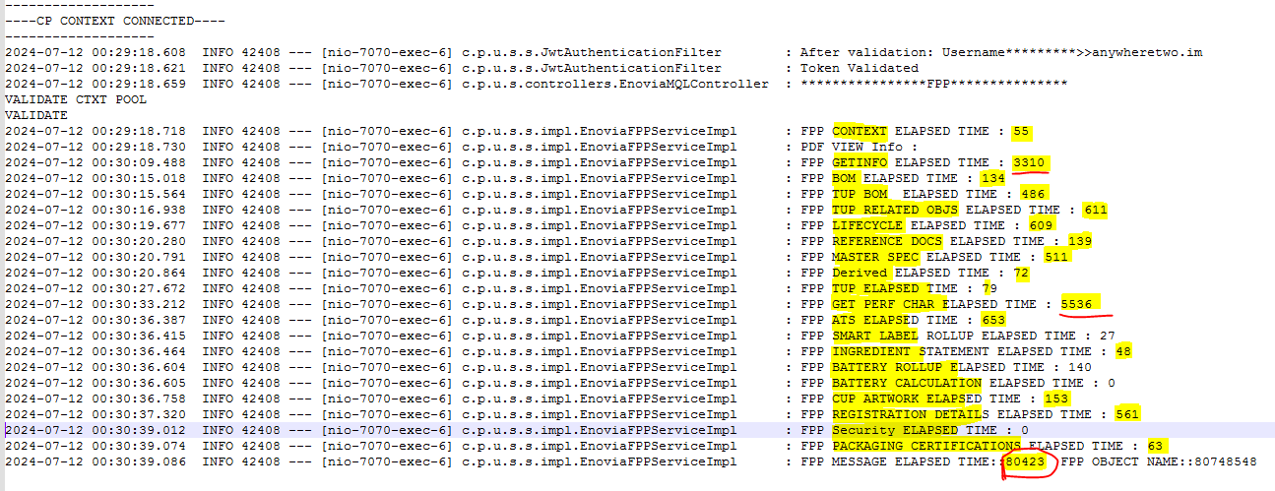
Requirement 5228 : Objects should take less than 15 seconds to load on the page (2/4)
Current Approach to load an Object:
Send Request with ID
Data Collection
Spec Reader DB
UI
MS
MQL
(Enovia)
< 2 Minutes
3 Minutes
2 Mins wait MAX
<null>
Processing….

Slide 4
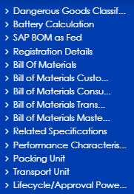
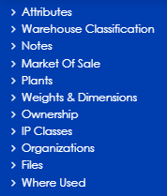
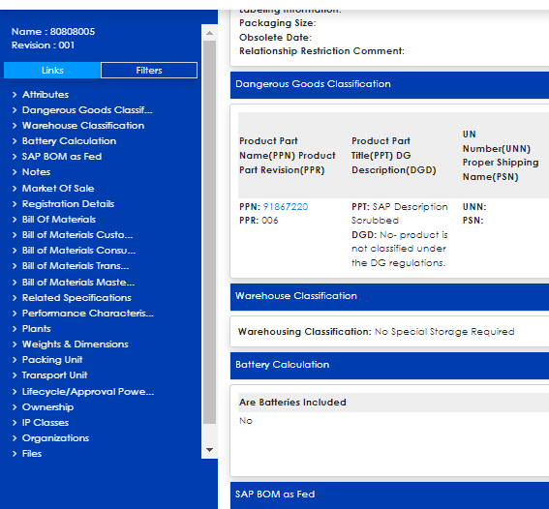
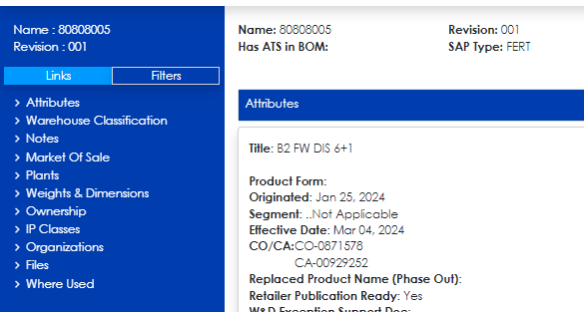
Requirement 5228 : Objects should take less than 15 seconds to load on the page (3/4)
Proposed Solution 1:
Request 2
Request 2
Request 1
Request 1
</fpp/Categories/{searchId/}>
Send Request with ID
Data Collection
Spec Reader DB
UI
MS
MQL
(Enovia)
3 Minutes
2 Mins wait MAX
< 15 to 25 sec
<JSON 1>
<JSON 2>
Response 1
Initial Load
Response 2
Complete Load

Slide 5
Requirement 5228 : Objects should take less than 15 seconds to load on the page (4/4)
Challenges:
“Filter View” selection
Notes:

Slide 6
Thank You

